Slide 1
Identifying Ethical Risks
Ethical Reasons
Stumbling Blocks for Ethical Reasoning
Identify Ethical Risks in Product Development
Tools for Identifying Ethical Risks
Use Regulations, Standards, and Human Rights to Identify Ethical Risks

Slide 2
Ethical Reasons
Topic A

Slide 3
What is Ethical Reasoning?
Ethical reasoning: The process of identifying and evaluating reasons for action.
Ethical reasons: Considerations that count in favor of, or against, a certain course of action.
Benefits of ethical reasoning:
Make decisions consciously and reflectively.
Justify actions in terms others can understand and accept.
Avoid bad decisions due to bias or fallacies.

Slide 4
Types of Reasons
Rights
Rights are entitlements to act or be treated in certain ways. They generate weighty reasons, often amounting to obligations, for ethical decision-making.
Interests
Interests, particularly economic interests, typically generate reasons that reflect concern for tangible benefits, such as jobs, money, or economic opportunity.
Values
Values generally present reasons for respecting what people find desirable, such as autonomy, spirituality, or fairness.
These categories are not mutually exclusive. Sometimes the lines get blurred. Different kinds of reasons can have different roles when it comes to moral reasoning.

Slide 5
Rights and Duties
Rights:
What we can reasonably expect other people and society to do to protect our interests.
Many rights protect basic needs and interests.
UN Universal Declaration on Human Rights contains a list of rights that are commonly regarded as fundamental.
Duties:
What we and others need to do to protect rights and interests of self and others.
Most (not all) duties correspond to rights.
Often referred to as “moral obligation.”
Consider both rights and duties when participating in ethical reasoning.

Slide 6
Interests
Interests: Ethical reasons that reflect concern for tangible benefits or intangible values.
People, groups, and other sentient beings all have interests.
Economic interests:
Concern for a tangible benefit, such as jobs, money, or economic opportunity.
Can be shared among many people, requiring trade-offs to ensure fair treatment.
Interests and values:
Intangibles like privacy, dignity, and liberty.
Again, sharing interests like these can require trade-offs.

Slide 7
Values
Values: Ethical reasons that reflect concern for intangible benefits, or what people find desirable.
Conditions that are desirable or believed to be desirable.
Broad consensus can mask disagreement over details.
Not all values are shared.
Address values after addressing rights and interests.
Values can evolve with time and technological advancement.

Slide 8
Activity: Discussing Ethical Reasons
Scenario: General discussion.
Can you describe a situation when different ethical reasons came into play and conflicted with one another?
In your opinion, what are the values that are widely agreed on, and which are less so?

Slide 9
Stumbling Blocks for Ethical Reasoning
Topic B

Slide 10



Myths About Ethics
Technical solutionism: The assumption that technology alone suffices to solve any ethical issue.
Moral relativism: The view that ethics is completely subjective, and that trying to identify the right thing to do is therefore pointless.
Moral righteousness: The attitude that all who disagree with one's own ethical position are wrong.

Slide 11
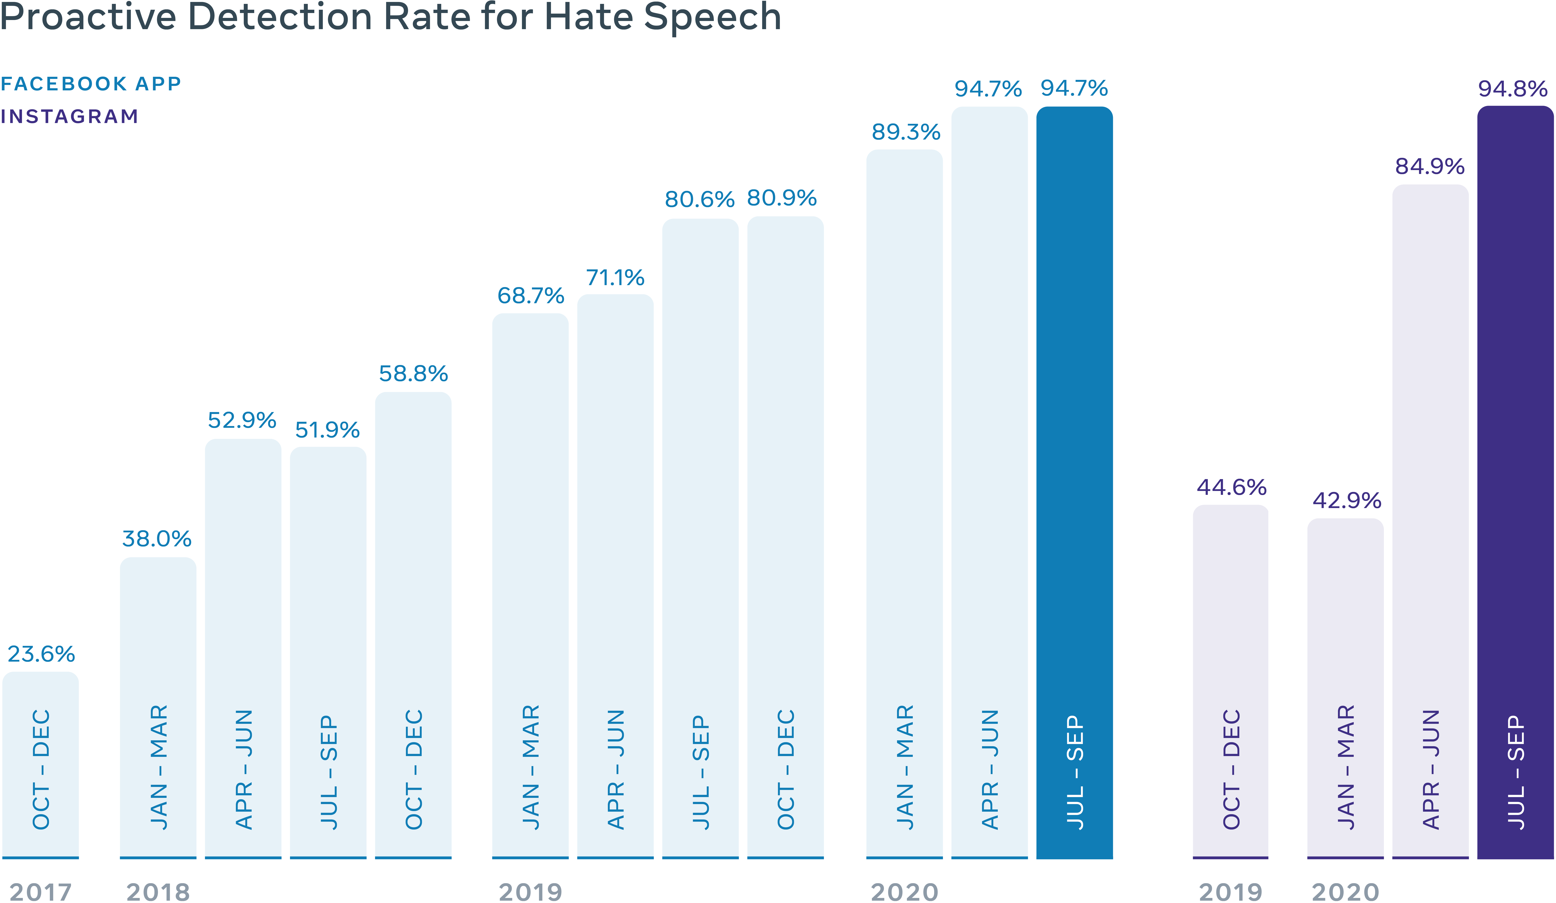

Technical Solutionism
Technical solutionism: The assumption that technology alone suffices to solve any ethical issue.
Facebook has made significant progress in building algorithms that detect hate speech.
But technology alone cannot solve every ethical issue.
In fact, capturing the nuance, history, and changing cultural norms of hate speech requires ethical reasoning.
Source: https://about.fb.com/news/2021/11/measuring-progress-combating-hate-speech/

Slide 12
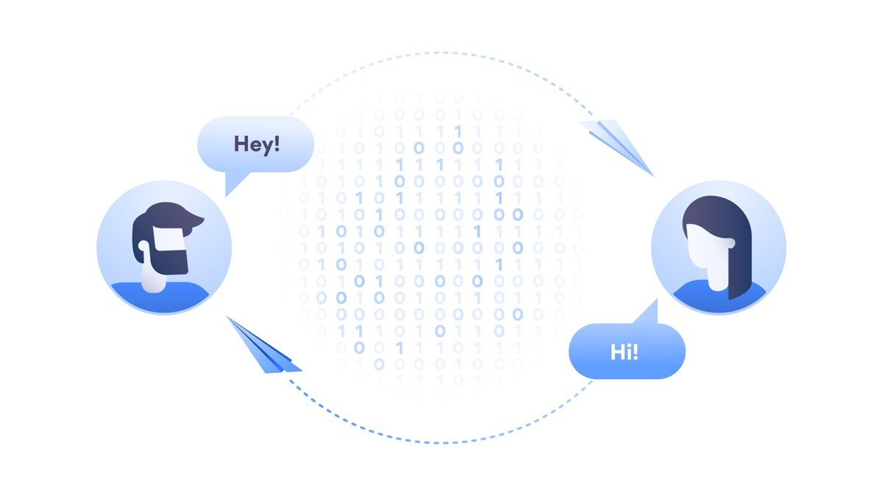

Moral Relativism
Moral relativism: The view that ethics is completely subjective, and that trying to identify the right thing to do is therefore pointless.
Relativism is right that we should be tolerant of difference.
Some ethical tradeoffs are difficult to make, and people passionately disagree.
Yet some arguments about what we ought to do are supported by stronger reasons than others.
Encryption: Privacy or Safety?
Privacy
vs.
Safety

Slide 13
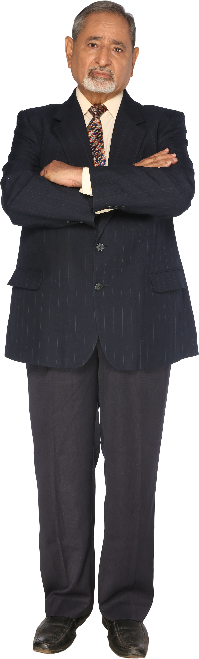

Moral Righteousness
Moral righteousness: The attitude that all who disagree with one's own ethical position are wrong.
I am right.
Moral righteousness makes us unwilling to listen to people who take a different view.
The morally righteous tend to stick to like-minded people and despise those who disagree.
Yet ethical reasoning depends on open-mindedness and intellectual humility.

Slide 14


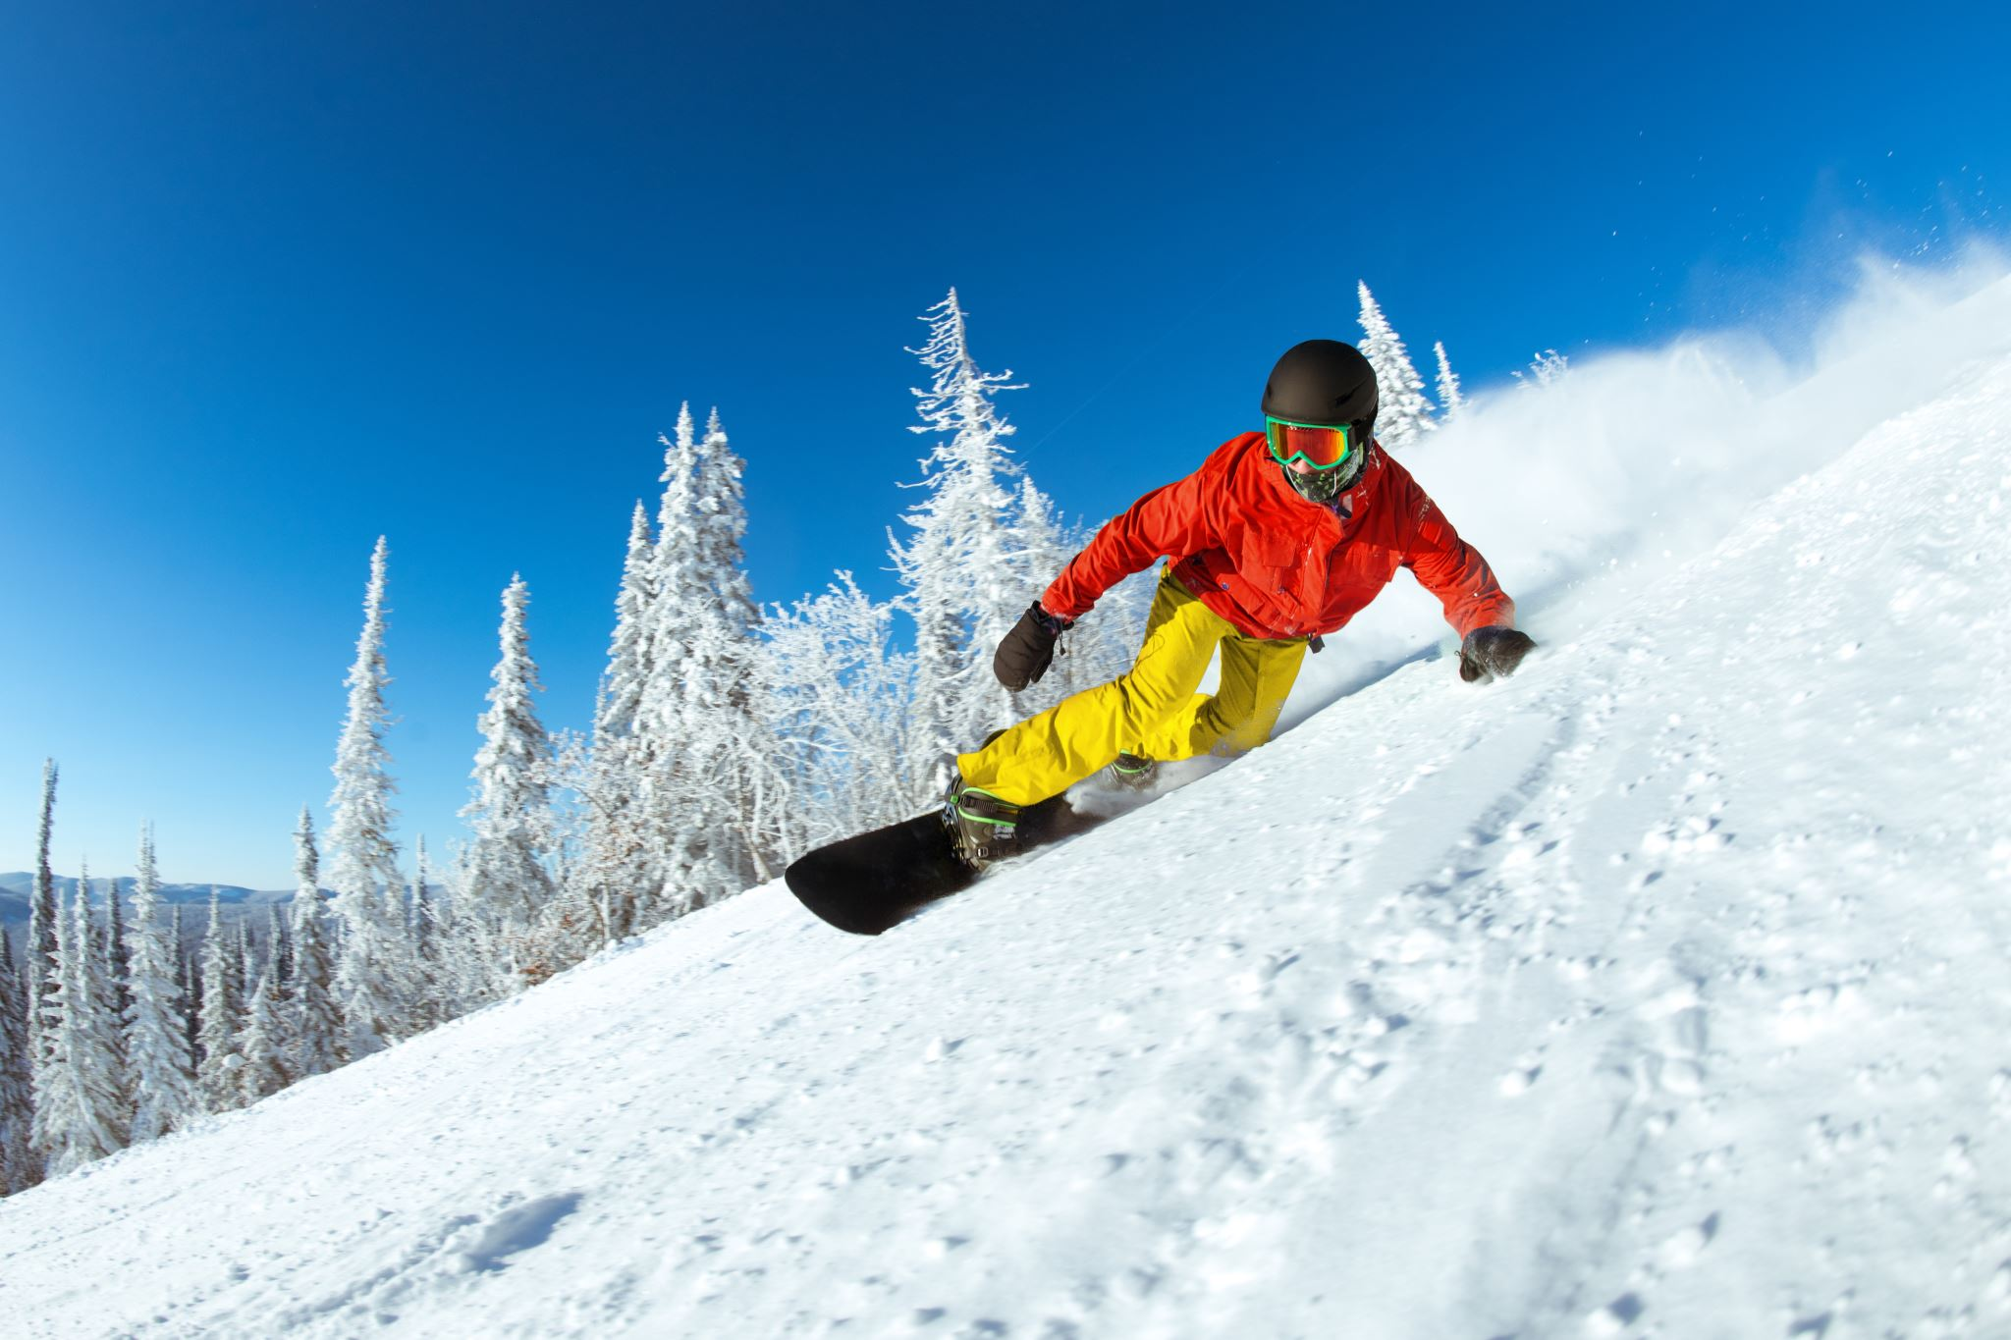

Reasoning Fallacies
Overgeneralization and stereotypes
“Computer scientists are shy and nerdy.”
Slippery slope
“If we do X, nothing will stop us from slipping into Y.”
Appeal to authority
“X says Y, and if X says so, it must be right!”

Slide 15
Activity: Discussing Ethical Reasoning Stumbling Blocks
Scenario: General discussion.
How would you respond to a colleague who insists that ethics is “just a matter of personal opinion”? Try to think of this in the context of a business need.
How would you respond to a colleague who wonders whether more effective technology should make ethical reasoning obsolete?

Slide 16
Identify Ethical Risks in Product Development
Topic C

Slide 17
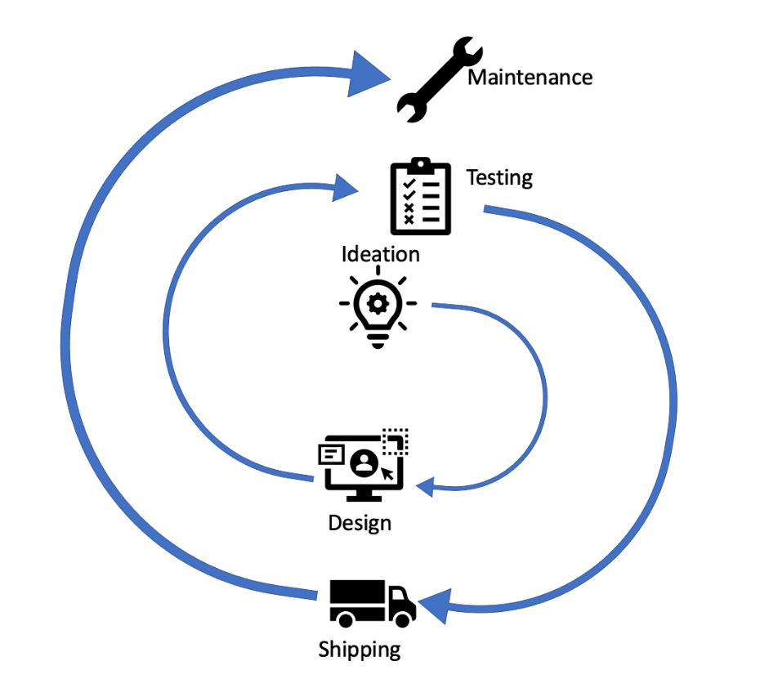
Ethical Risks in the Product Development Lifecycle
Ideation and prototyping
Development and testing
Getting ready to ship
Maintenance

Slide 18






Why Are Ethical Risks Often Overlooked?
Failure to consider key stakeholders’ rights, interests, and values
“Not my problem!”
Lack of clear, consistent practices

Slide 19
How Can We Anticipate and Identify Ethical Risks?
1.
Consider affected stakeholders’ rights, interests, and values.
2.
Give everyone responsibility for identifying ethical risks.
3.
Build and conduct regular exercises for anticipating and identifying ethical risks.

Slide 20


Meet RudiBrace
Product team is part of Rudison Technologies.
Team mission: Help organizations increase productivity by fostering team interaction and communication among colleagues.
RudiBrace is a digital bracelet that offers a new way to track employee activity.

Slide 21
The RudiBrace Team
Team members:
Project manager
Hardware engineer
Data scientist with AI specialization
User experience (UX) designer
Software engineer
Goal: engage ethics into the entire product development lifecycle.
Prototype phase:
Sensor box for testers to carry.
Mockup dashboard for managers to view data.
Mockup Slack plug-in for testers to use.
After prototype testing, external testing at another company.
Silicon Valley software company
10,000+ employees in a large office complex

Slide 22
Ethical Risks of RudiBrace
RudiBrace will gather large quantities of sensitive user data.
Data needs to be securely stored and transferred.
Worker privacy needs to be protected.
Algorithms developed by the team might affect the daily routine of workers.
This should not lead to unfair practices.
Employees have interests to protect.
Understand what data the device collects and for which purposes.
Have ways to hold their employer accountable for how it uses the data.

Slide 23
Activity: Identifying Potential Risks the RudiBrace Team Might Face
Scenario: RudiBrace project.
Are there any stakeholders whose interests, rights, or values the RudiBrace team might fail to consider? If so, who?
Is there a risk that ethical issues might fall through the cracks due to the way the team is structured? If so, what might you suggest to reduce that risk?

Slide 24
Tools for Identifying Ethical Risks
Topic D

Slide 25
Commonly Used Tools
Consequence scanning
Scenario analysis
Stakeholder cards

Slide 26
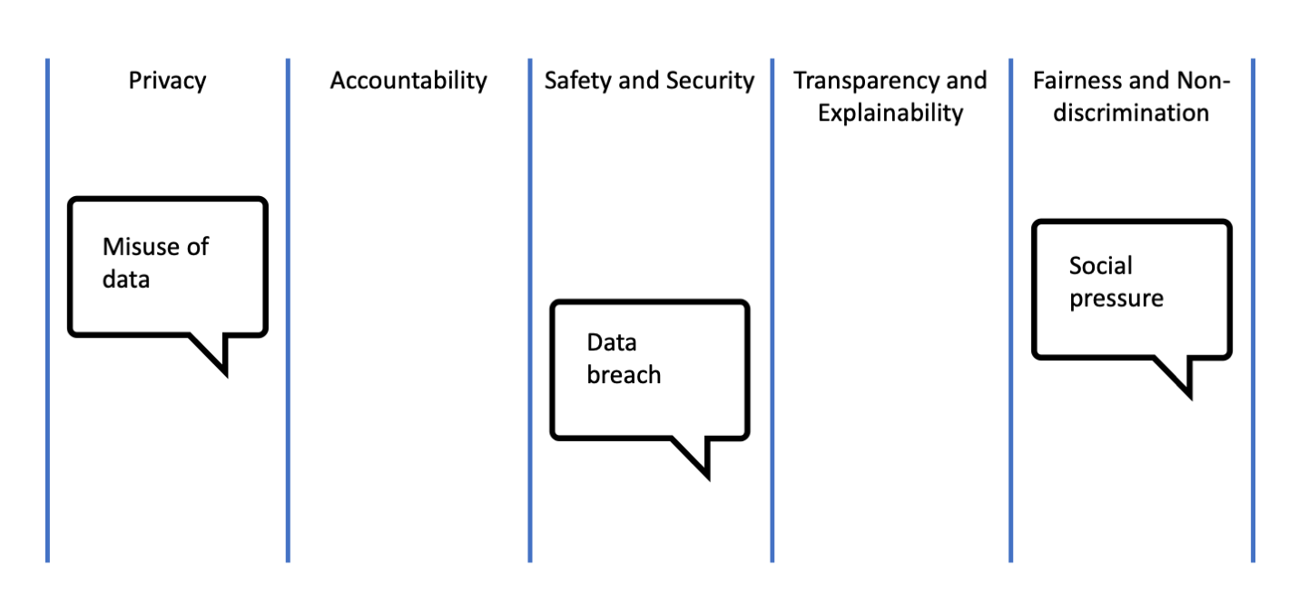
Consequence Scanning
Key ethical considerations: Concepts that tend to capture the most important areas of ethical concern in emerging technology.
Consequence scanning: A tool for identifying ethical risks that uses key ethical considerations to categorize possible issues and their effects on the product.

Slide 27
Scenario Analysis
Scenario analysis: A tool used for identifying ethical risks in a product development lifecycle by asking "what if“ questions about the product.
Questions to ask:
What if our product contributed to the emergence of a surveillance state?
How could our product contribute to this?
What other ways might our product be used to violate privacy?
The Ethical OS Tool cites 8 primary risk zones:
Risk Zone 1: Truth, Disinformation, Propaganda
Risk Zone 2: Addiction and the Dopamine Economy
Risk Zone 3: Economic and Asset Inequalities
Risk Zone 4: Machine Ethics and Algorithmic Biases
Risk Zone 5: Surveillance State
Risk Zone 6: Data Control and Monetization
Risk Zone 7: Implicit Trust and User Understanding
Risk Zone 8: Hateful and Criminal Actors

Slide 28
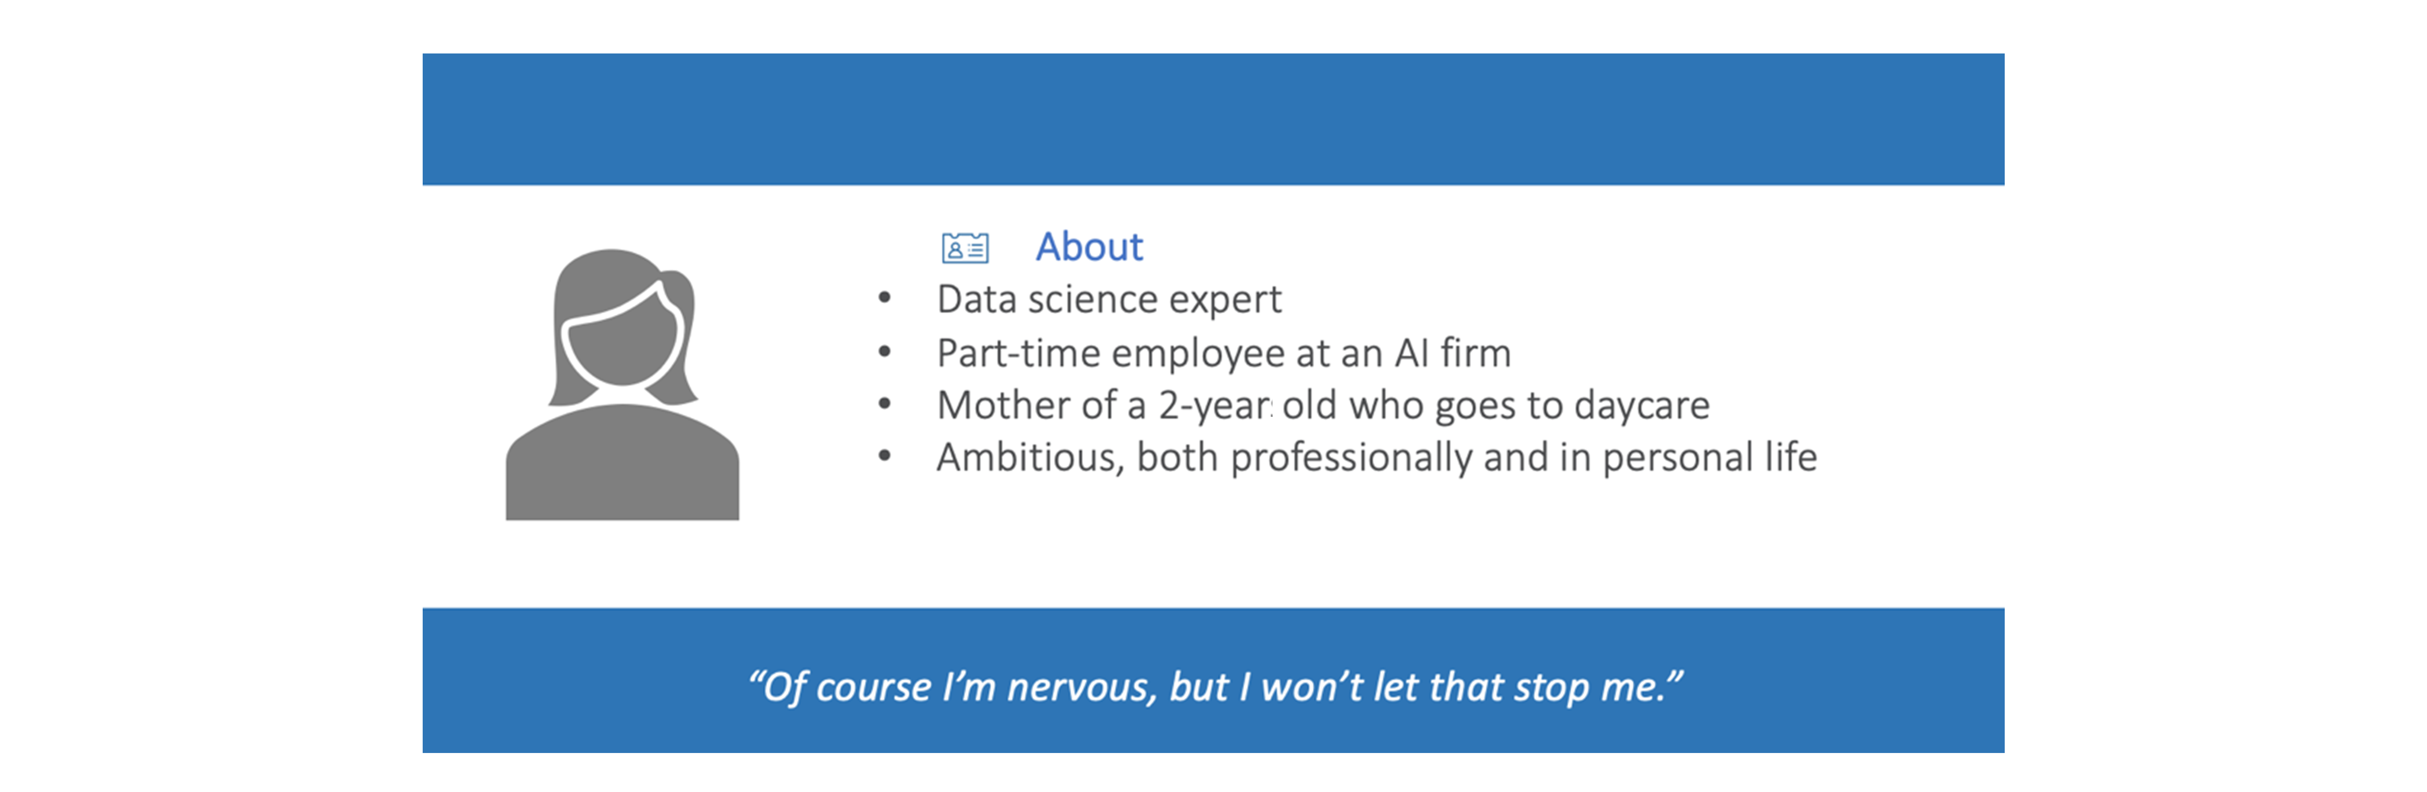
Stakeholder Prompts
Stakeholder prompts: Tools for identifying ethical risks through stakeholder engagement.

Slide 29
Activity: Using Consequence Scanning
Scenario: RudiBrace product.
Privacy | Accountability | Safety/Security | Transparency/ Explainability | Fairness/Non-Discrimination
Misuse of data

Slide 30
Use Regulations, Standards, and Human Rights to Identify Ethical Risks
Topic E

Slide 31
The Relation Between Standards, Regulation, and Ethics
Standards
Regulations
Guidelines
Ethical principles can be used to create and criticize standards, regulations, and guidelines.
Ethical Principles

Slide 32
Regulations
Regulation: A set of rules made by a sovereign legislative body, often in consultation with subject matter experts.
Features of regulations:
Have legal standing and are enforceable.
Often to seek ethical minimum standards.
Help to screen out unethical options.
Examples:
General Data Protection Regulation (GDPR)
Health Insurance Portability and Accountability Act of 1996 (HIPAA)
UK Equality Act of 2010

Slide 33
GDPR
GDPR: (General Data Protection Regulation) A pan-European data protection law that expands the rights of individuals to control how their personal data is collected and processed.
Protects individual privacy by holding data collection and data processing entities accountable for the information of EU citizens.
Applies to all entities that collect or process the personal data of EU citizens, even if the entity is not based in the EU.
Includes provisions concerning the export of personal data outside of the EU.
Summarization:
It upholds the privacy rights of individuals (e.g., the right to correct inaccurate personal data).
It enforces restrictions and security obligations for organizations (e.g., report data breaches within 72 hours).
It issues penalties for noncompliance (e.g., fines up to €20 million or 4 percent of global turnover).

Slide 34
Data Privacy Regulations and Ethical Risks
Theme | Principle | Implication for RudiBrace
Fairness and transparency | Data collection must be fair and transparent. | Need to explain to users which data is collected and what happens with it. Need to consider whether fairness requires an opt-out option for employees.
Purpose limitation | Organizations should collect personal data only for a specific purpose, clearly state what that purpose is, and collect data only for as long as necessary to complete that purpose. | The data gathered with the tool cannot be used beyond the stated purpose.
Accuracy | Every reasonable step must be taken to erase or rectify data that is inaccurate or incomplete. | Need to ensure that the metrics computed really capture interaction and communication and are appropriately linked to productivity.
Integrity and confidentiality | Data processing needs to ensure appropriate security of the personal data. | Given the sensitivity of the data collected by RudiBrace, the tool needs to meet exceptionally high security standards.

Slide 35
Standards
Standard: A rule or guideline created by industry and civil society organizations to establish common norms for interoperability, product quality, and professional conduct.
Features of standards:
Do not have legal standing but can be enforced with incentives and sanctions conferred by professional bodies.
Important mechanism for establishing and interpreting ethical requirements for emerging technology.
Are developed by experts and may not represent viewpoints of all affected groups.
Examples:
International Standards Organization (ISO)
Institute of Electrical and Electronics Engineers (IEEE)
Forest Stewardship Council (FSC)

Slide 36
Standards and Ethical Risks
Standards often focus on implementing legal regulations and ethical best practices.
Well-suited to provide concrete technical guidance and policy details that can help to concretize ethical risks.
Aim to be in sync with the views of experts on how best to operationalize an ethical requirement.
For RudiBrace, the team could refer to ISO Standard 27701.
Relates to the way an organization collects personal data and prevents unauthorized use or disclosure.
Contains detailed guidance that the RudiBrace team should take into account when building the product, including guidance on:
Incident management
Access to systems and services that process personal identifiable information
Cryptographic protection
Information transfer policies

Slide 37
Human Rights
Human rights: Rights accorded to human beings that create a protective zone around persons and allow them the opportunity to further their valued personal projects without interference from others.
Examples of human rights:
Security of the person
Due process and a fair trial
Right to work and own property
Freedom of movement, speech, religion, marriage, and political participation
Freedom from discrimination
Features of human rights:
Complement standards and regulation when filtering permissible options.
Apply generally to all organizational activity and are widely accepted as ethical minimum standards.
Can be used to anticipate negative impacts when regulation and standards lack sufficient guidance.

Slide 38


Important Human Rights Documents
International Bill of Human Rights
Universal Declaration of Human Rights
International Covenant on Civil and Political Rights
International Covenant on Economic, Social and Cultural Rights
Declaration on Fundamental Principles and Rights at Work

Slide 39
The Role of Organizations with Respect to Human Rights
UN Guiding Principles on Business and Human Rights include:
Avoid infringing on the human rights of others and address adverse human rights impacts with which they are involved.
Respect human rights as an ethical red line, regardless of whether human rights are legally binding or enforced in your jurisdiction.

Slide 40
Human Rights Due Diligence
Human rights due diligence: A way for organizations to proactively manage the effect of any potential or actual adverse human rights impacts with which they are involved.
Assess actual and potential human rights impacts
Integrate and act upon findings
Track results
Communicate how impacts are addressed

Slide 41
Human Rights and Ethical Risks
Identify human rights relevant to your product.
Ask: Are there risks that our product will fail to respect human rights?
Toronto Declaration: A statement on human rights standards for machine learning that focuses on avoiding discrimination. Recommendations include:
Identify potential discriminatory outcomes.
Take effective action to prevent and mitigate discrimination and track responses.
Be transparent about efforts to identify, prevent and mitigate against discrimination in machine learning systems.
After consulting the Toronto Declaration, the RudiBrace team might learn that it needs to pay attention to how their product may have discriminatory impacts on employees.

Slide 42
Activity: Using Regulations, Standards, and Human Rights to Identify Ethical Risks
Scenario: RudiBrace product team.
Navigate to the report titled Ethics guidelines for trustworthy AI stored in the European Commission's document library.
Read the summary information. Do you think the assessment list mentioned in the final paragraph is a regulation or a standard?
Why did you provide the answer you did?
Read the first 2 or 3 bullets that describe the 7 key requirements that AI systems should meet. What are some practical learnings the RudiBrace team can take from this?

Slide 43
At your workplace, what types of situations have you experienced that required you to use ethical reasoning?
Of the tools and practices discussed in this lesson, which do you think will be the most effective at your workplace?

